Slide 1
Opening the treasure trove of legacy giving at no or very little cost!
By Richard Radcliffe FCIoF Cert
Introduced by Chris Pitt Group Impact Director, Benefact Group
October 2022

Slide 2
Welcome from the Benefact Group
An international group of financial services businesses, that gives all available profits to charities and good causes.
Notes:
I’d like to welcome you to today’s webinar – Legacy fundraising. Thanks for taking the time to join us.
Today’s session will be an hour and a half – I’m just going to give a quick introduction then pass over to our fundraising expert Richard who will be running the session.
A few housekeeping points to start with:
Please do use the chat function – it’s a great tool to network, share ideas and thoughts throughout the session. In previous webinars it’s been fantastic to see charities sharing top tips in the comments, so please do feel free to introduce yourself in the chat now. I know we have a wide range of charities joining so it would be great to hear about all the different causes represented and where you are from.
If you have any questions, please add these to the Q&A button. Chris will try to pick up a few of these at the end. So comments in the comments section and specific questions in the Q&A.
This webinar is being recorded – so don’t worry if you miss anything - it will all be available to watch back on the Benefact fundraising hub afterwards. The slides will also be available on the hub afterwards.
To start with I’d like to give some context about who we are for those of you who don’t us. We are the Benefact Group – made up of around 20 different specialist financial services businesses – with one common aim: to give to good causes like yours.
We’re owned by a charitable trust, Benefact Trust (formally known as Allchurches Trust), which means our purpose really is different – we’re generating profits so we can give them away.

Slide 3
About the Benefact Group
The UK’s 4th largest corporate donor
Our common purpose is to give all available profits to good causes
Notes:
The group also gives in it’s own right. We’re currently the UK’s 4th large corporate donor, with ambitions to do even more.

Slide 4
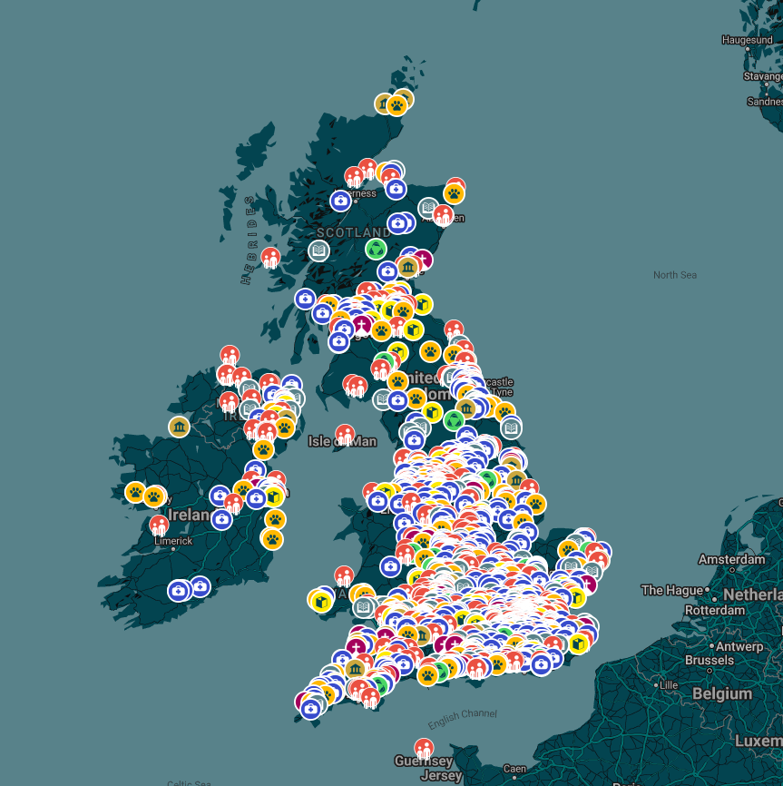
Movement For Good
Launched in 2019 with smaller and larger grants
Movementforgood.com
Supported thousands of charities across the UK
2022 Movement for Good awards are now open
This year we are donating more than £1 million
Notes:
Our flagship giving programme is Movement For Good. Movement For Good started in 2019, and as you can see from the map on the right since then we’ve given to a huge range of causes up and down the country.
We have smaller awards of £1,000 available – anyone can nominate and charity to receive one of these. Nominations are open all year round, with three draws throughout the year. So if anyone hasn’t applied yet – we would encourage you to do so and share with your supporters – the more nominations you receive, the more likely it is your cause is drawn.

Slide 5
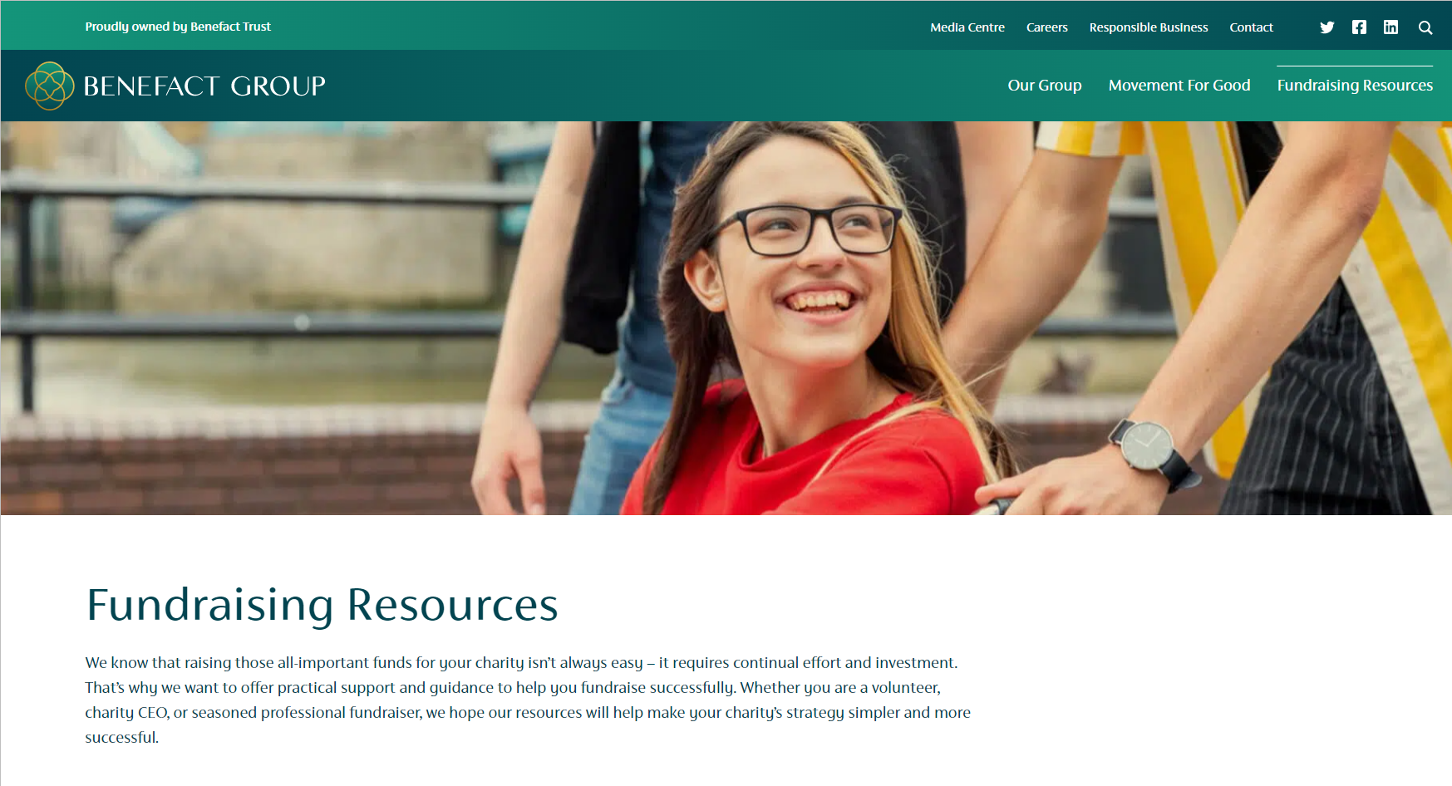
Fundraising support from the Benefact Group
benefactgroup.com/fundraising-resources
Notes:
As well as giving directly to charities, we want to enable you to raise even more. That’s why since 2020 we’ve been producing a range of tools and resources to help you with fundraising. All our resources can be found on our online fundraising hub – benefactgroup.com/fundraising-resources
And this is where you will be able to find the recording of this session and slides afterwards.

Slide 6
Over to Richard…

Slide 7
Who am I?
45 years in fundraising.
35 years specialising in gifts in Wills
I have met over 35,000 charity supporters including donors, volunteers and service users in legacy focus groups
I have developed over 500 strategies from the very small to the global
Trained over 40,000 people.
My life is driven by ensuring every person is happy with information they see about gifts in Wills

Slide 8
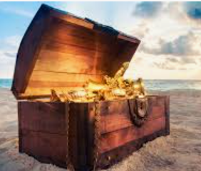
Legacies are an unrestricted
Treasure trove
And the best vaccine for long term financial health for any charity of any size

Slide 9
Giving is changing
Individual giving UK
2007 – £11 billion
2021 – £11 billion
Legacy giving
2007 £1.7 billion
2021 £3.3 billion
And due to double again in the next 20 years!
One more fact: 20 years ago 3,000 charities received legacies annually.
NOW it is 10,000

Slide 10
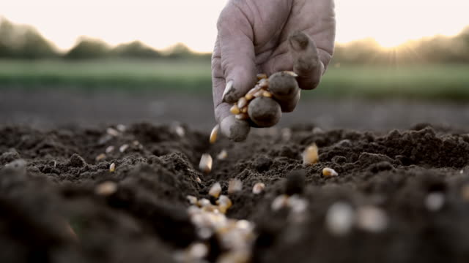
Would you like good news?
NEVER EVER EVER will you ask anyone for a legacy.
All you are doing is sowing the seed
This is an information campaign

Slide 11
But first – which word(s) do you like best?
A bequest in your Will
A legacy in your Will
A gift in your Will
Remember us in your Will
BUT
“Remember us” preferred by older people (and it is great in November)

Slide 12
Legacy language
Specific = an item
Pecuniary = cash
Residuary = share or percentage or fraction of an estate

Slide 13
How a typical Will with a legacy works
Specific and pecuniary legacies tend to be distributed FIRST
After these, 100% of residue is distributed and any share or percentage or fraction can be left to anyone or any charity (i.e. % to your charity) which is great for supporters with families

Slide 14
They are perfect in a financial crisis

Slide 15
This is my family. Are you interested? You should be!

Slide 17
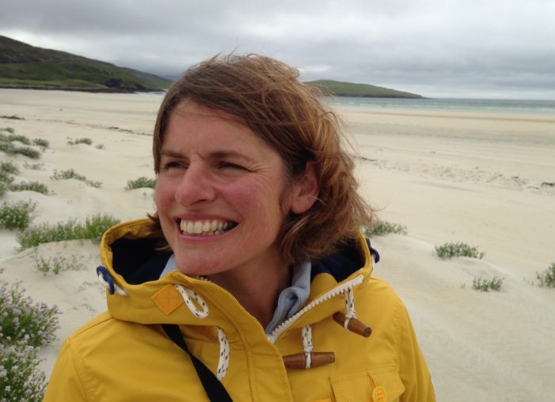

Slide 20
So
Those closest to you inherit:

Slide 21
Talking of my family
Which do you prefer to use?
family
your loved ones
those you care about
those closest to you

Slide 22
Current legators
60%
female
40%
men

Slide 23
Typical legator wealth
£480,000 at death – not a rich person! But they have something to leave
The wealthy leave legacies.
Cash poor but asset OK people leave legacies.
In fact anyone can do it!

Slide 24
32%- 58% of them are remembering a charity in their Will

Slide 25
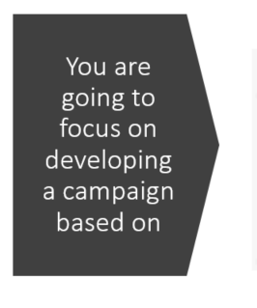
You are going to focus on developing a campaign based on

Slide 26
First: do people understand HOW you are funded?
Which do you prefer and can be used? (one example is being used)
Did you know:
70% of our funding is from voluntary donations including gifts in Wills the rest is from government
1 in 3 of our services are funded thanks to voluntary income including gifts in Wills.
Without voluntary income we would not be able to help 1 in 3 patients/those in need etc
OR
Run a series of “Did you know?” articles and posters.

Slide 27
Other “did you know” questions
Did you know we were founded in XXXX imagine what you can help us achieve in the next XXXX years with a gift in your Will.
Did you know you can leave our charity even 1% in your Will which means those closest to you inherit the remaining 99%?
Did you know you might save £400 inheritance tax for every £1,000 you leave us in your Will?
Did you know the only information your adviser needs to include us in your Will is our registered charity name and number?

Slide 28
Other phrases
The following phrases can be included in any conversation and in thank you letters and events.
Some are better spoken others written.
Some are good some are dreadful to make you think.
One of the following phrases can be in EVERY communication and each one might raise a fortune.
It’s your call!

Slide 29
Phrases to think about
What do you think of the following
If the time is right for you to remember a charity in your will please remember our charity
When the time is right for you to remember a charity in your will please remember our charity
Answer: either but never give them the choice by offering “if or when”

Slide 30
Size and stats!
Legacies sound big – but they need not be. £50 is welcome and so is £5 million even though we prefer big ones!
Every gift in every Will makes a difference however large or small
Wrong
It should be:
Every gift in every Will however large or small makes a difference
In your Will even 1% can make a difference so your other inheritors receive 99%.
Research shows on average you will live eight years longer if you leave us a legacy

Slide 31
Action for phrases
Where can funding statements go?
Pull up at events?
PS in thank you letters
Email signatures
Banners on website
Welcome packs

Slide 32
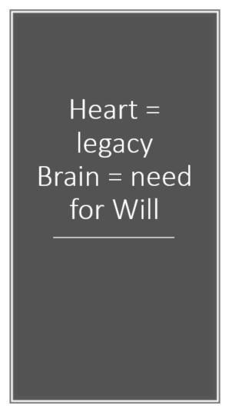
Heart = legacy Brain = need for Will

Slide 33
Typical Will patterns of prospects
50% of 50 year olds have a Will
80% of 80 year olds have a Will
65% of Wills are usually out of date
Typical Will making ages:
38
68
80
This helps you focus your words on whether to mention writing or updating your Will

Slide 35
What motivates a gift in a Will?
Family and feelings
Thank you
Personal experience
please

Slide 36
Question asked by ALL legacy prospects
“WHY should I give a legacy and what will it achieve?”
Without a clear legacy vision you will not give yourself the best chance to succeed

Slide 37
Legacy case for support
Your legacy vision should have:
Past successes
Current successes
Future need – quantify if possible
You can have:
Long ones and short ones
A vision for each programme/service

Slide 38
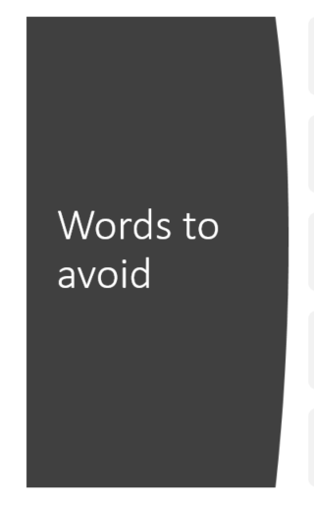
Words to avoid
Legacy
Bequest
Pecuniary
Residuary
Estate

Slide 39
Words and phrases to use
Gift in your Will
Remember our charity in your Will
A modest cash sum
A small % in your Will – even 1% can make a difference
Future generations
Those following in our footsteps
You will be remembered

Slide 40
The best conversations start when you

Slide 41
Pepper all presentations with questions

Slide 42
Five good “questions” for conversations
How much do you know about our charity?
Do you know where we get our money from?
Where (or how) do you think we support people/animals etc?
Tell me more about how you like to support charities?
How do you feel about a gift in your Will to our charity?

Slide 43
Next big BUT – which channels WORK? 1st the nudgers
Social media
Newsletters
bookmarks
Message Integration and
PS in communications
These open the brain possibly at the best moment.

Slide 46
So if you are willing to consider a Gift in your Will. What information do you need?
It could not be easier
Name of our charity:
Registered Charity Number:
Only decision: size and type of gift

Slide 47
Oscar Wilde said
Some people bring happiness wherever they go, others whenever they go
Keep legacy communications upbeat!

Slide 48
If you need me
Richard Radcliffe
richard@radcliffeconsulting.org
Mobile: 07771896680
www.radcliffeconsulting.org

Slide 49
www.benefactgroup.com/fundraising
Benefact Group plc Reg. No. 01718196. Registered in England at Benefact House, 2000 Pioneer Avenue, Gloucester Business Park, Brockworth, Gloucester, GL3 4AW, United Kingdom.

Slide 50
https://fundsonline.org.uk/
https://www.dsc.org.uk/training/
https://www.dsc.org.uk/publication/the-complete-fundraising-handbook/
https://www.dsc.org.uk/publication/the-directory-of-grant-making-trusts-2020-21/
https://www.dsc.org.uk/training/in-house-training/
Thank you to the Benefact Group for choosing Directory of Social Change to deliver this webinar.
Evaluation Forms will be emailed to you separately. Please return so that we can all continue to improve our support for you.
Our speakers today was Richard Radcliffe. If you’d like to work with them on further training and development do get in touch with us at DSC
Did you know DSC offer an In House Training Service on a huge range of topics?
Or that we can provide Performance Coaching and Mentoring?
Contact us to find out more or visit www.dsc.org.uk
Cathy Shimmin, Senior Training Consultant
cshimmin@dsc.org.uk 07967 027304

