Slide 1
Social Media Fundraising
By Nick Day
Introduced by Benefact Group
November 2022

Slide 2
We’ll Cover
Introduction
Where to start?
What to post on social media?
Do you need to pay?
What tone of voice should you use?
Q&A

Slide 3
Welcome from the Benefact Group
An international group of financial services businesses, that gives all available profits to charities and good causes.
Notes:
I’d like to welcome you to today’s webinar – social media fundraising. Thanks for taking the time to join us.
Today’s session will be an hour and a half – I’m just going to give a quick introduction then pass over to our digital fundraising expert Nick who will be running the session.
A few housekeeping points to start with:
Please do use the chat function – it’s a great tool to network, share ideas and thoughts throughout the session. In previous webinars it’s been fantastic to see charities sharing top tips in the comments, so please do feel free to introduce yourself in the chat now. I know we have a wide range of charities joining so it would be great to hear about all the different causes represented and where you are from.
If you have any questions, please add these to the Q&A button. We will pick these up at the end. So comments in the comments section and specific questions in the Q&A.
This webinar is being recorded – so don’t worry if you miss anything - it will all be available to watch back on the Benefact fundraising hub afterwards.
To start with I’d like to give some context about who we are for those of you who don’t us. We are the Benefact Group – made up of around 20 different specialist financial services businesses – with one common aim: to give to good causes like yours.
We’re owned by a charitable trust, Benefact Trust, which means our purpose really is different.

Slide 4
About the Benefact Group
The UK’s 4th largest corporate donor
Our common purpose is to give all available profits to good causes
Notes:
The group also gives in it’s own right. We’re currently the UK’s 4th large corporate donor, with ambitions to do even more.

Slide 5
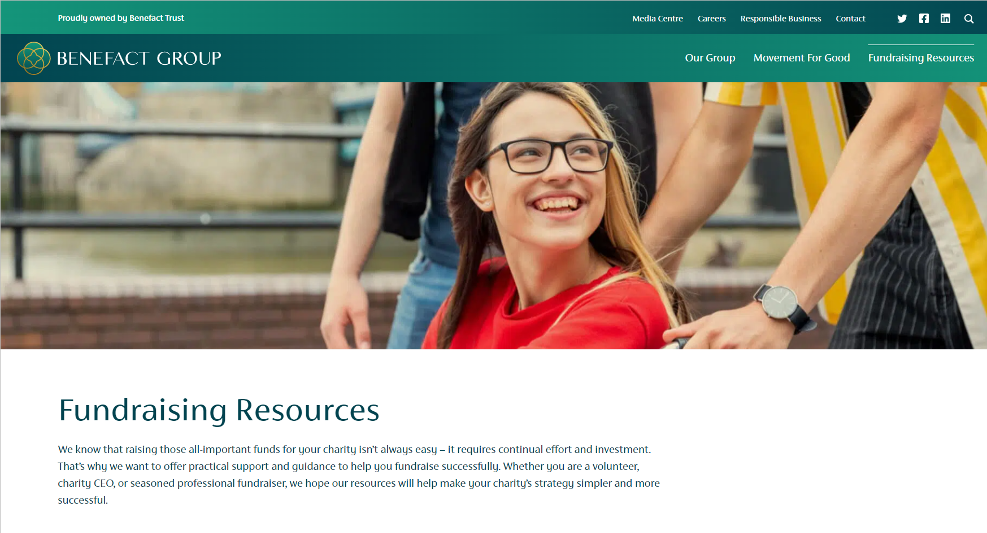
Fundraising support from the Benefact Group
benefactgroup.com/fundraising-resources
Notes:
As well as giving directly to charities, we want to enable you to raise even more. That’s why since 2020 we’ve been producing a range of tools and resources to help you with fundraising. All our resources can be found on our online fundraising hub – benefactgroup.com/fundraising-resources
And this is where you will be able to find the recording of this session and slides afterwards.

Slide 6
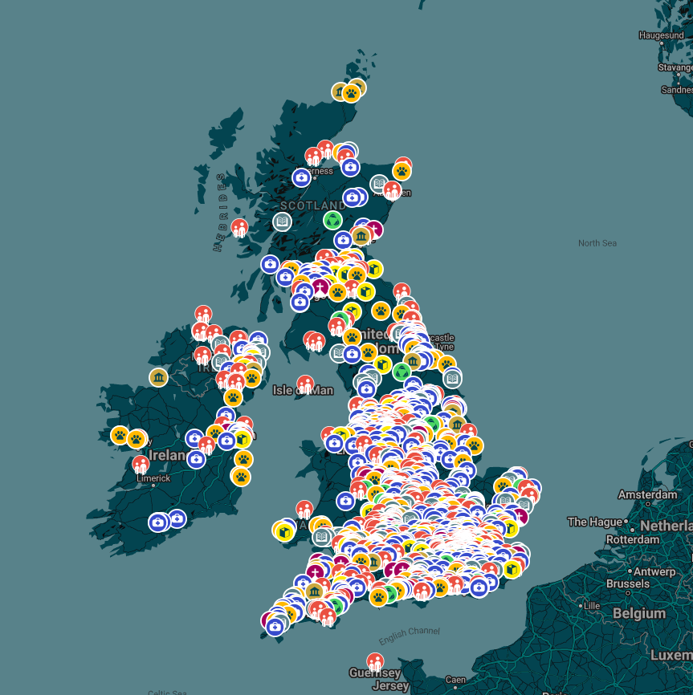
Movement For Good
Launched in 2019 with smaller and larger grants
Movementforgood.com
Supported thousands of charities across the UK
2022 Movement for Good awards are now open
This year we are donating more than £1 million
Notes:
Our flagship giving programme is Movement For Good. Movement For Good started in 2019, and as you can see from the map on the right since then we’ve given to a huge range of causes up and down the country. And I’m pleased that we’ve given to lots of you on the webinar today – and hopefully more of you in the future.
We have smaller awards of £1,000 available – anyone can nominate and charity to receive one of these. Nominations are open all year round, with three draws throughout the year. So if anyone hasn’t applied yet – we would encourage you to do so and share with your supporters – the more nominations you receive, the more likely it is your cause is drawn.

Slide 7
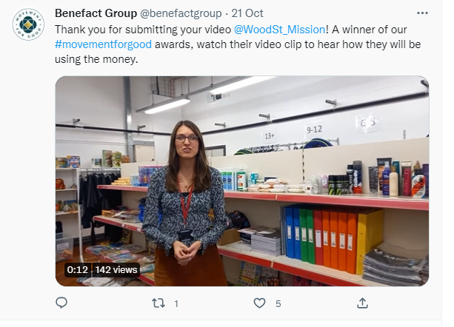
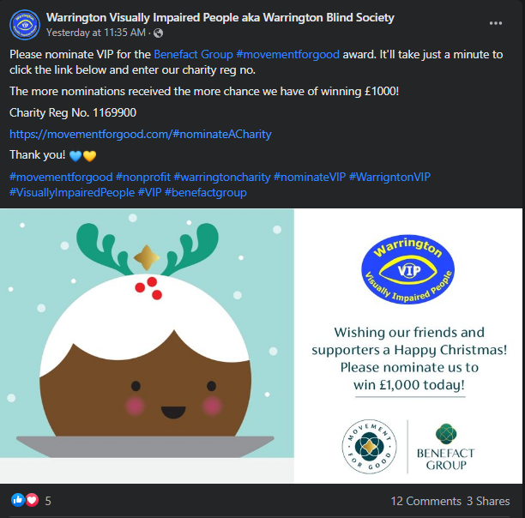
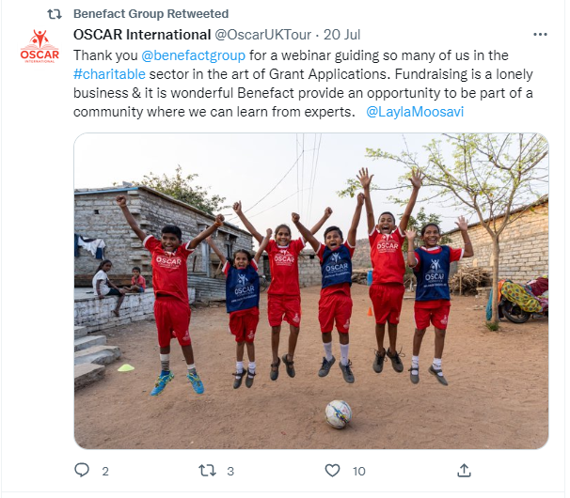
Movement for Good & social media
We see how charities are using social media to engage their followers and increase nominations...

Slide 8
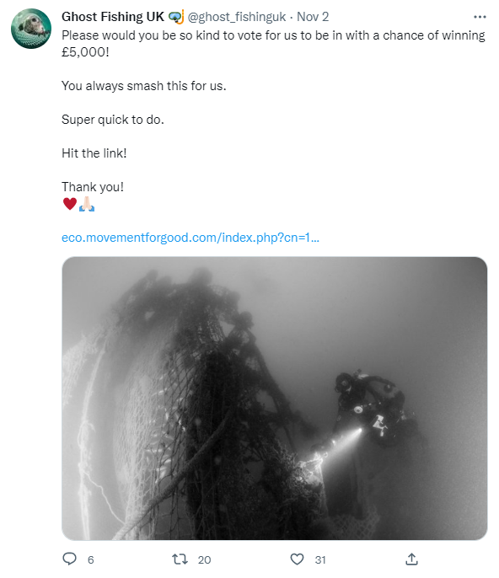
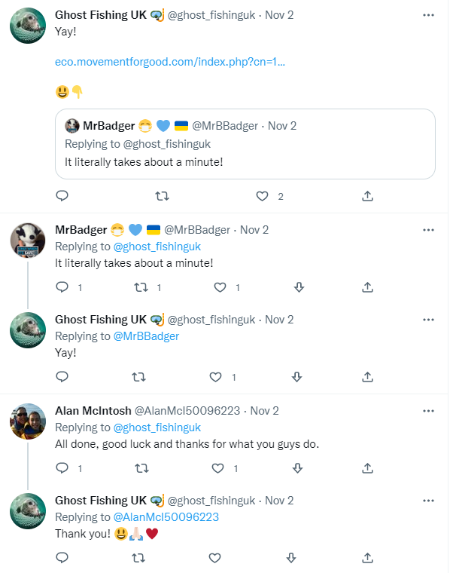
Case Study – Ghost Fishing UK

Slide 9
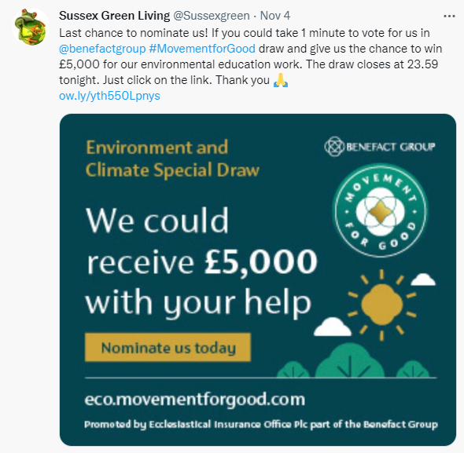
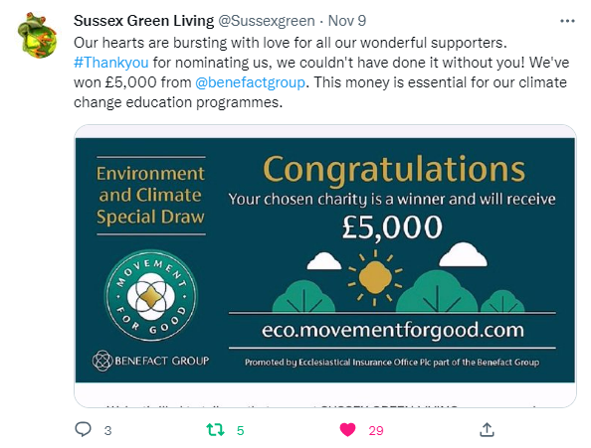
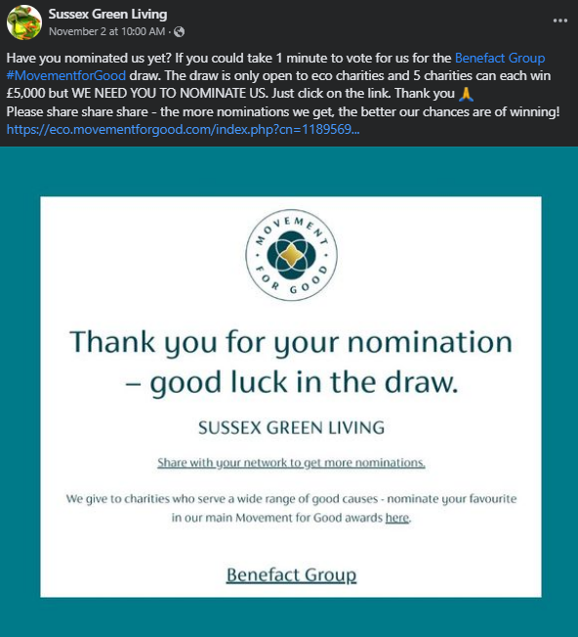
Sussex Green Living

Slide 10
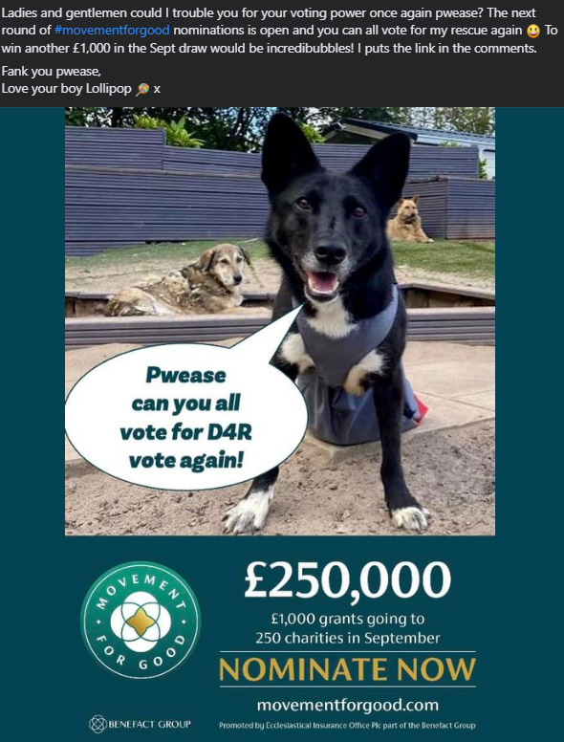
Dogs 4 Rescue

Slide 11
Movement for Good & social media
Be social savvy – our 3 top tips:
Content
Videos & Images – making your content personable.
Tools that could help.
Engage
Why is engagement important?
Ways to interact with your audience.
Reach
Reaching new people, you could be surprised!

Slide 12
A festive message for social media

Slide 13
Over to Nick…

Slide 14
Where to start?
Evaluation of the main platforms, how to select which ones are right for you and how to get started with them, including donation functionality.

Slide 15
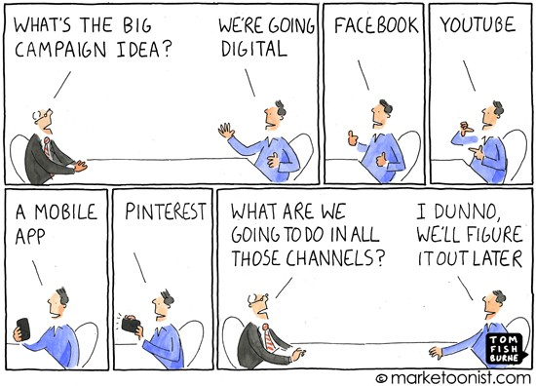
Where to Start?

Slide 16
Start With Your Target Audiences!
What do they look like?
What are their interests?
What matters most to them?
What communication channels do they like best?

Slide 17
Reach
The total number of people an organisation is able to reach across all of its social media networks.
Reach can be organic (free) or paid.
Reach

Slide 18
Engagement
The interaction between people and brands on social networks. For example, on Facebook likes, comments and shares or Twitter likes, replies and RTs.
Engagement

Slide 19
3 Key Uses
Say – posting content or updates which the audience can respond to.
Show – posting content that can tell a story about a brand.
Share – online conversations that organisations have with their audience

Slide 20
Poll
Facebook is the world’s most popular social media platform. But which of the following is the next most popular?
Twitter
Instagram
YouTube
TikTok

Slide 21
Social Media Popularity

Slide 22
Facebook Evaluation
Benefits
Reach and engage with large audiences.
Provide depth and detail about organisation.
Generate website traffic, event attendees and donations
Can create highly targeted communications to users that like page or to wider Facebook community.
It’s low cost (and free to a certain extent).
It’s instant – can take advantage of opportunities or deal with a crisis in real-time.
It can increase brand awareness and loyalty.
Donation and Fundraiser functionality.
Shop functionality.
Limitations
Organic reach is low, and organisations need to pay to gain further reach.
Page posts are affected by algorithm.
Gen Z and Millennials prefer other networks.

Slide 23
Instagram Evaluation
Benefits
Highly engaged users.
High proportion of Gen Z and Millennials use the platform.
Great for organisations who have visual content to share with audiences.
Help to build trust in the organisation through creating an emotional connection with audiences through imagery.
Using #hashtags can assist with users finding new content and accounts.
Shopping functionality.
Limitations
Visual platform – limited click through opportunities available.
Introduced algorithm, so not all posts will be seen by all users.
More adverts within the platform which could affect organic reach.

Slide 24
Twitter Evaluation
Benefits
Reach a large audience.
Generate leads and traffic to web presence.
Connect with influencers in an industry and local community easily.
SEO benefits – Tweets can create links and be viewed in search engines.
Can create additional PR coverage.
Can provide improved supporter insight.
Can provide improved customer satisfaction through customer service use.
Limitations
Limited characters on posts.
Large number of spam accounts and bots.
Time sensitive platform.
Any negative criticism can be viewed publicly.
Has a reputation for fuelling trolls.
User growth is stalling.
Uncertain future?

Slide 25
LinkedIn Evaluation
Benefits
Reach and network with a large audience of business professionals.
Can be a good (and free) lead generation tool.
Can help the organisation establish its credibility and authenticity.
Can help attract top talent.
Organisations can create shareable content.
Limitations
LinkedIn advertising can be expensive compared to other platforms.
Many users have complained about the non-business content now being shared on the platform.
Not all users are actively engaged on the platform or visit frequently.
Niche audience – limited to B2B.

Slide 26
Using Hashtags
What is a Hashtag?
Hashtags are a way to connect social media content to a specific topic, event, theme or conversation.
They also make it easier to discover posts around those specific topics, because hashtags aggregate all social media content with that same hashtag.
They’re not just for Twitter anymore, either. Hashtags are effective on other social media platforms too.
How many Hashtags should be used on a Post?
Facebook: 1-2 hashtags
Twitter: 1-2 hashtags
LinkedIn: 2-3 hashtags
Instagram: up to 30 hashtags
https://blog.hootsuite.com/how-to-use-hashtags/

Slide 27
Social Media Algorithms
Facebook
Prioritises meaningful interactions to generate friendly conversations
LinkedIn
Prioritises connection strengths and engagement to showcase quality business content
Instagram
Prioritises quality and relevancy to display the best content to the most people
Twitter
Prioritises timing and relevancy to provide users with most relevant content

Slide 28
The Benefits of Social Media
5C Categories | Purpose | Application examples
Communicating: publishing & sharing content | Publishing, discussing, expressing oneself, sharing, influencing | Twitter, Blogger, TikTok, YouTube, Instagram, SlideShare, Messenger
Collaborating: collective content creation | Creating content together, collaborating | Clubhouse, Instagram
Connecting: networking people | Socialising, networking, playing, entertaining | Facebook, LinkedIn, Instagram, TikTok
Completing: adding, describing and filtering | Describing content, subscribing updates, rating | Feedly, Pinterest, Yelp
Combining: mixing and matching | Combining other tools & tech according to needs | Hootsuite, Sprout Social

Slide 29
What to post on social media?
Quality content is key to driving engagement and relationship building leading to donation. How you can create and achieve a balance across the content types: Inspire, Entertain, Inform, Persuade.

Slide 30
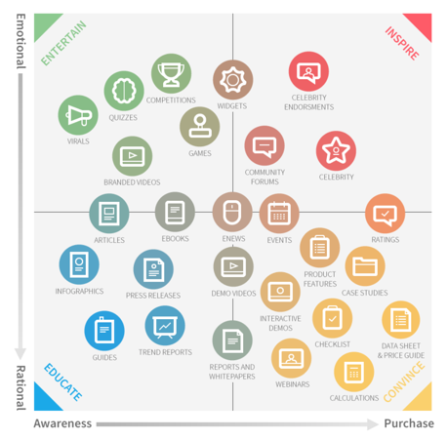
The Content Marketing Matrix
The content marketing matrix shows some of the different content marketing options available to:
Inspire
Entertain
Educate
Convince

Slide 31
Poll
What types of content do you enjoy the most?
Monetary value: e.g. discounts, competitions
Knowledge value: e.g. ‘how to’ videos
Personal value: e.g. wellbeing, productivity
Utility value: e.g. mileage calculator, journey planner
Entertainment value: e.g. funny video

Slide 32
Social Media Content
Content Type | Benefits | Limitations
Video | Highly engaging content Video can be easily shared socially (possible viral effect) Can help build brand trust, credibility and position organisation as experts | Videos can be time consuming to produce and edit Poor video or audio can affect brand perception Younger users don’t often watch full length of video
Stories (Snapchat, Facebook, Instagram) | Shows authenticity of brand Provides engaging content Can delete story if there is an issue/error Can direct users to ‘see more’ with links | Non-permanent content Have to be recorded on a mobile device Cannot use or share content on other social platforms
Live Broadcast/video | Shown more in newsfeed algorithms Enables real connection to be made with audience – intimate experience Create sense of community enabling interaction between brand and followers | The entire audience will not be notified of live broadcast Issues with ‘live’ nature of media (errors, mistakes)
Gifs | Adds visual variety to social media feed A great gif is worth a thousand words Highly engaging, easy to share. | If misused, they can devalue a message or brand

Slide 33
Social Media Content
Content Type | Benefits | Limitations
Quizzes | Interactive content and can capture data Increased popularity on social networks | Usually only undertaken once by a user
Competitions | Can assist in creating user generated content Easy to share Can capture consumer data | Subject to regulations Can be hard to administer
Games | Good for encouraging engagement Can provide an interactive element | Resource intensive and required technical expertise
Meme | Humorous and fun – can help create brand personality Easy to share on social media | If misused, they can devalue a message or brand
Infographics | Eye catching Can make the stats or material more appealing to the reader | Require creative resource to generate and can therefore, be expensive

Slide 34
Social Media Content
Content Type | Benefits | Limitations
eBooks | Helps to strengthen authority within a field A powerful method of sharing knowledge Useful for capturing prospect data | Resource intensive – require time and expertise to write
Webinars | Well suited to training and demos Can enable data capture of prospects | Limited audience interaction Possible technical issues using webinar software
Case Studies | Helpful in influencing prospects to make a decision Can showcase proof of organisation expertise and showcase success | Can sometimes be viewed as self promotion Reliant on clients or customers giving permission for inclusion
White papers | Useful for providing complex technical information in a concise format Creates credibility and shows expertise Useful for capturing prospect data | Can be resource intensive and expensive to create

Slide 35
The 4-1-1 Rule For Social Media Content
4 x pieces of new content
1 x repost
1 x self-serving post
New Content Posts
New content isn’t necessarily freshly published, but it is content that you have found, on other people’s sites or blogs, that you think would be interesting and relevant to your audience. It is content that is “new” because you are adding it to the social media conversation.
Reposts
Reposts are posts that you retweet or share from other social media users. This is a way to build relationships with other brands or people on social media and to share more relevant content with your audience.
Self-Serving Posts
Self-serving posts are pretty self-explanatory. These are the posts that promote your organisation. They could be announcements, links to your website, links to content you have created or any other type of post that promotes you.

Slide 36
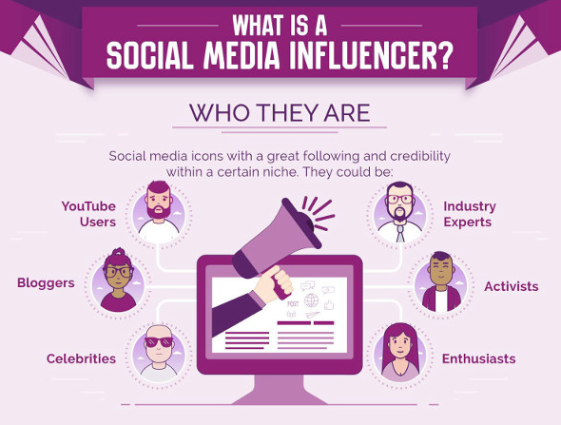
Using Social Media Influencers
Consider the 3Rs:
Relevance: Is the influencer sharing content and developing a following that is relevant to the brand and target segment?
Reach: What is the total number of people that could be reached through the influencer’s follower base?
Resonance: What is the potential level of engagement the influencer could create with an audience?

Slide 37
6 Attributes of Great Content
Attractive
Discoverable
Consumable
Understandable
Shareable
Actionable
Chaffey and Bateman (2016)

Slide 38
Visual/Image Content Creation Tools
Canva is, without a doubt, one of the most popular design platforms out there and a tool that even the world's least creative people could use to create stunning visuals across a range of formats. https://www.canva.com/en_gb/
Remove enables you to remove backgrounds using AI in a matter of seconds and saving you hours cutting out images to use in your visuals. https://www.remove.bg/
Piktochart is perfect for people with no design skills to create beautiful infographics that look professional and help elevate your business's content. https://piktochart.com/

Slide 39
Do you need to pay?
Organic (free) reach on social media is in decline. Key considerations to help you decide when to pay and how to budget.

Slide 40
Organic Reach in Decline
It’s no secret that most social platforms operate on a pay-to-play model for brands.
On Facebook, the average reach of an organic page post hovers around 5.20%.
That means roughly one in every 19 fans sees the page’s non-promoted content.

Slide 41
Reasons to Pay
Get posts seen by more people Increasing reach is one of the main reasons to invest in paid advertising. Whilst your activity might get in front a decent amount of people, algorithms now mean organic posts receive much less visibility than they once did. Adding a little budget to posts means you can guarantee it is seen by more people – and even better – people you decide should see it.
Get more people talking about your brand Increasing engagement is a great way to get seen by your target audience. It also gives people a certain level of trust via third party validation and ‘social proof’. If others are commenting, sharing and engaging with your posts it gives people more confidence in you as a brand. Paying for initial engagements also helps your content travel further.
Get in front of key individuals & decision makers One of the benefits of paying for reach and engagement is the ability to truly hone in on the individuals you want to see/ engage with your posts.

Slide 42
Reasons to Pay
Build brand awareness Consciously or subconsciously, brand awareness is a huge factor in an individual’s buying decision. Getting your brand in front of people where possible and relevant is key to pushing them (gently) in the right direction. It’s not always about the hard sell either, sometimes it’s a helpful blog or video that tells them something they didn’t know.
A small budget can make a big difference Even adding a small amount can make a huge difference. A little push goes a long way and getting the first bit of engagement can make or break a campaign. This means that you don’t have to throw a lot of cash to see the return on investment, the difference is clear and tangible.
It’s all part of the mix Having the right paid/organic mix is vital in getting the most from your social activity. Social media has always been about encouraging genuine, meaningful interaction and the focus should always be on creating engagement organically where possible. Adding a paid element into the mix should work to facilitate this engagement by giving your content a boost by increasing your reach and putting it in front of the right people. Producing content that is relevant to your audience should be the priority. If you strike the right balance you can generate worthwhile, genuine engagement as well as real interest in your organisation.

Slide 43
What tone of voice should you use?
A consistent and confident approach needs to be adopted across multiple platforms. Key considerations to help you define the right tone of voice and integrate with other digital channels.

Slide 44
Tone of Voice and Social Media
Your brand tone of voice comes down to your organisation’s identity.
However, each social media platform is unique and users will have different expectations.
While it’s important that your identity remains recognisable across multiple social media platforms, you can tweak it depending on the platform.
Use your social media accounts as an opportunity to show off different aspects of your brand’s personality.

Slide 45
Facebook Tone of Voice
32.7 million Brits use Facebook and it is currently the most popular social media platform globally, so it’s really important for your organisation to get the right tone of voice when sharing content on this site.
Facebook is the best social media site to use an informal, playful and engaging tone of voice. Aim to be personable, friendly, and humorous when crafting updates.
A Facebook content strategy including images, blogs, competitions, well-chosen memes, Facebook Live, and helpful advice is a great way to build engagement and target potential supporters.

Slide 46
Instagram Tone of Voice
Instagram is all about pretty things and good aesthetics.
All you need to crack this app is good quality pictures and a light hearted, inviting tone.
Use the captions to ask your customers questions and share updates and don’t forget to use hashtags – it’s okay to go wild with them.
Make people want to click on your page by using features such as Instagram Live, IGTV, polls, questions and mini quizzes on Instagram stories.

Slide 47
Twitter Tone of Voice
Twitter is all about interaction, so your tone of voice should be human. Being bold can be profitable, although it’s always best to err on the side of caution, especially when commenting on anything political.
Your Twitter marketing strategy should take advantage of Twitter’s features, including images, hashtags, threads, polls and questions.
Since retweets can help your content reach a much wider audience, driving traffic to your organisation in the process, it’s definitely worth spending time thinking about how you want your Tweets to be received and how you can encourage them to get shared.

Slide 48
LinkedIn Evaluation
On LinkedIn, you’re selling your organisation and the people behind it, rather than the product or service that your organisation provides.
Optimising your presence on LinkedIn can help you to find high-quality B2B leads and strengthen your brand identity along the way.
Given that LinkedIn is a professional networking site, it’s best to keep your tone of voice reasonably formal. The type of content that you share needs to reflect the professional focus of the site.
Show off your credentials, share articles, webinars or expert opinion.
Leave the memes to Facebook!

Slide 49
11 Steps to Success with Social Media
Be current – only set up those you have time/resource to manage
Be consistent – relies on user’s developing habits so fit with that
A distinctive and consistent personality will give you standout
Use your current supporter base – get them committed to your media choices
Be prepared to invest time and effort in creating great content
Engage proactively – to both good and bad comments

Slide 50
11 Steps to Success with Social Media
Good manners and etiquette are important – you are representing an organisation, not yourself!
Manage expectations to what you can deliver
Encourage people to share – with prompts and calls to action
Encourage dialogue – no one likes someone who only talks about themself!
Integrate with other media via plugins, media logo + id etc.

Slide 51
www.benefactgroup.com/fundraising
Benefact Group plc Reg. No. 01718196. Registered in England at Benefact House, 2000 Pioneer Avenue, Gloucester Business Park, Brockworth, Gloucester, GL3 4AW, United Kingdom.

Slide 52
https://fundsonline.org.uk/
https://www.dsc.org.uk/training/
https://www.dsc.org.uk/publication/the-complete-fundraising-handbook/
https://www.dsc.org.uk/publication/the-directory-of-grant-making-trusts-2020-21/
https://www.dsc.org.uk/training/in-house-training/
Thank you to the Benefact Group for choosing Directory of Social Change to deliver this webinar.
Evaluation Forms will be emailed to you separately. Please return so that we can all continue to improve our support for you.
Our speakers today was Richard Radcliffe. If you’d like to work with them on further training and development do get in touch with us at DSC
Did you know DSC offer an In House Training Service on a huge range of topics?
Or that we can provide Performance Coaching and Mentoring?
Contact us to find out more or visit www.dsc.org.uk
Cathy Shimmin, Senior Training Consultant
cshimmin@dsc.org.uk 07967 027304

Slide 53
Links
https://www.gwi.com
https://www.goodbox.com/2021/10/the-best-social-media-fundraising-campaigns/
https://econsultancy.com/eight-inspiring-social-media-campaigns-from-the-charity-sector/
https://charitydigital.org.uk/topics/topics/world-social-media-day-the-most-impactful-campaigns-of-2021-8961
https://yourengineroom.com/blog/why-paid-social-media-advertising/
https://www.fundingcircle.com/uk/resources/marketing/social-media/right-tone-voice-social-media-platform/
https://www.statista.com/statistics/272014/global-social-networks-ranked-by-number-of-users/
https://sproutsocial.com/insights/social-media-statistics/
https://blog.hootsuite.com/simon-kemp-social-media/
https://blog.hootsuite.com/how-to-use-hashtags/
https://blog.hootsuite.com/organic-reach-declining/
https://www.canva.com/en_gb/
https://www.remove.bg/
https://piktochart.com/
https://www.bigfootdigital.co.uk/do-you-follow-the-4-1-1-social-media-rule

